Slide 1
Chapter 7
Digital Design and Computer Architecture, 2nd Edition
David Money Harris and Sarah L. Harris

Slide 2
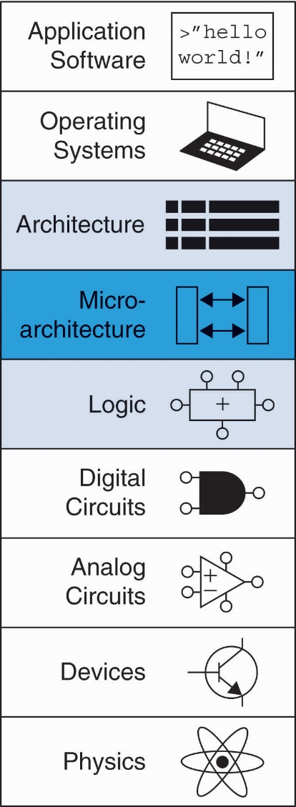
Chapter 7 :: Topics
Introduction
Performance Analysis
Single-Cycle Processor
Multicycle Processor
Pipelined Processor
Exceptions
Advanced Microarchitecture

Slide 3
Introduction
Microarchitecture: how to implement an architecture in hardware
Processor:
Datapath: functional blocks
Control: control signals

Slide 4
Microarchitecture
Multiple implementations for a single architecture:
Single-cycle: Each instruction executes in a single cycle
Multicycle: Each instruction is broken into series of shorter steps
Pipelined: Each instruction broken up into series of steps & multiple instructions execute at once

Slide 5
Processor Performance
Program execution time
Execution Time = (#instructions)(cycles/instruction)(seconds/cycle)
Definitions:
CPI: Cycles/instruction
clock period: seconds/cycle
IPC: instructions/cycle = IPC
Challenge is to satisfy constraints of:
Cost
Power
Performance

Slide 6
MIPS Processor
Consider subset of MIPS instructions:
R-type instructions: and, or, add, sub, slt
Memory instructions: lw, sw
Branch instructions: beq

Slide 7
Architectural State
Determines everything about a processor:
PC
32 registers
Memory

Slide 8
MIPS State Elements

Slide 9
Single-Cycle MIPS Processor
Datapath
Control

Slide 10
Single-Cycle Datapath: lw fetch
STEP 1: Fetch instruction

Slide 11
Single-Cycle Datapath: lw Register Read
STEP 2: Read source operands from RF

Slide 12
Single-Cycle Datapath: lw Immediate
STEP 3: Sign-extend the immediate

Slide 13
Single-Cycle Datapath: lw address
STEP 4: Compute the memory address

Slide 14
Single-Cycle Datapath: lw Memory Read
STEP 5: Read data from memory and write it back to register file

Slide 15
Single-Cycle Datapath: lw PC Increment
STEP 6: Determine address of next instruction

Slide 16
Single-Cycle Datapath: sw
Write data in rt to memory

Slide 17
Single-Cycle Datapath: R-Type
Read from rs and rt
Write ALUResult to register file
Write to rd (instead of rt)

Slide 18
Single-Cycle Datapath: beq
Determine whether values in rs and rt are equal
Calculate branch target address:
BTA = (sign-extended immediate << 2) + (PC+4)

Slide 19
Single-Cycle Processor

Slide 20
Single-Cycle Control

Slide 21
Review: ALU
F_{2:0} | Function
000 | A & B
001 | A | B
010 | A + B
011 | not used
100 | A & ~B
101 | A | ~B
110 | A - B
111 | SLT

Slide 22
Review: ALU

Slide 23
Control Unit: ALU Decoder
ALUOp_{1:0} | Meaning
00 | Add
01 | Subtract
10 | Look at Funct
11 | Not Used
ALUOp_{1:0} | Funct | ALUControl_{2:0}
00 | X | 010 (Add)
X1 | X | 110 (Subtract)
1X | 100000 (add) | 010 (Add)
1X | 100010 (sub) | 110 (Subtract)
1X | 100100 (and) | 000 (And)
1X | 100101 (or) | 001 (Or)
1X | 101010 (slt) | 111 (SLT)

Slide 24
Control Unit Main Decoder
Instruction | Op_{5:0} | RegWrite | RegDst | AluSrc | Branch | MemWrite | MemtoReg | ALUOp_{1:0}
R-type | 000000
lw | 100011
sw | 101011
beq | 000100

Slide 25
Control Unit: Main Decoder
Instruction | Op_{5:0} | RegWrite | RegDst | AluSrc | Branch | MemWrite | MemtoReg | ALUOp_{1:0}
R-type | 000000 | 1 | 1 | 0 | 0 | 0 | 0 | 10
lw | 100011 | 1 | 0 | 1 | 0 | 0 | 0 | 00
sw | 101011 | 0 | X | 1 | 0 | 1 | X | 00
beq | 000100 | 0 | X | 0 | 1 | 0 | X | 01

Slide 26
Single-Cycle Datapath: or

Slide 27
Extended Functionality: addi
No change to datapath

Slide 28
Control Unit: addi
Instruction | Op_{5:0} | RegWrite | RegDst | AluSrc | Branch | MemWrite | MemtoReg | ALUOp_{1:0}
R-type | 000000 | 1 | 1 | 0 | 0 | 0 | 0 | 10
lw | 100011 | 1 | 0 | 1 | 0 | 0 | 1 | 00
sw | 101011 | 0 | X | 1 | 0 | 1 | X | 00
beq | 000100 | 0 | X | 0 | 1 | 0 | X | 01
addi | 001000

Slide 29
Control Unit: addi
Instruction | Op_{5:0} | RegWrite | RegDst | AluSrc | Branch | MemWrite | MemtoReg | ALUOp_{1:0}
R-type | 000000 | 1 | 1 | 0 | 0 | 0 | 0 | 10
lw | 100011 | 1 | 0 | 1 | 0 | 0 | 1 | 00
sw | 101011 | 0 | X | 1 | 0 | 1 | X | 00
beq | 000100 | 0 | X | 0 | 1 | 0 | X | 01
addi | 001000 | 1 | 0 | 1 | 0 | 0 | 0 | 00

Slide 30
Extended Functionality: j

Slide 31
Control Unit: Main Decoder
Instruction | Op_{5:0} | RegWrite | RegDst | AluSrc | Branch | MemWrite | MemtoReg | ALUOp_{1:0} | Jump
R-type | 000000 | 1 | 1 | 0 | 0 | 0 | 0 | 10 | 0
lw | 100011 | 1 | 0 | 1 | 0 | 0 | 1 | 00 | 0
sw | 101011 | 0 | X | 1 | 0 | 1 | X | 00 | 0
beq | 000100 | 0 | X | 0 | 1 | 0 | X | 01 | 0
j | 000100

Slide 32
Control Unit: Main Decoder
Instruction | Op_{5:0} | RegWrite | RegDst | AluSrc | Branch | MemWrite | MemtoReg | ALUOp_{1:0} | Jump
R-type | 000000 | 1 | 1 | 0 | 0 | 0 | 0 | 10 | 0
lw | 100011 | 1 | 0 | 1 | 0 | 0 | 1 | 00 | 0
sw | 101011 | 0 | X | 1 | 0 | 1 | X | 00 | 0
beq | 000100 | 0 | X | 0 | 1 | 0 | X | 01 | 0
j | 000100 | 0 | X | X | X | 0 | X | XX | 1

Slide 33
Review: Processor Performance
Program Execution Time
= (#instructions)(cycles/instruction)(seconds/cycle)
= # instructions x CPI x T_{C}

Slide 34
Single-Cycle Performance
T_{C} limited by critical path (lw)

Slide 35
Single-Cycle Performance
Single-cycle critical path:
T_{c} = t_{pcq_PC} + t_{mem} + max(t_{RFread}, t_{sext} + t_{mux}) + t_{ALU} + t_{mem} + t_{mux} + t_{RFsetup}
Typically, limiting paths are:
memory, ALU, register file
T_{c} = t_{pcq_PC} + 2t_{mem} + t_{RFread} + t_{mux} + t_{ALU} + t_{RFsetup}

Slide 36
Single-Cycle Performance Example
Element | Parameter | Delay (ps)
Register clock-to-Q | t_{pcq_PC} | 30
Register setup | t_{setup} | 20
Multiplexer | t_{mux} | 25
ALU | t_{ALU} | 200
Memory read | t_{mem} | 250
Register file read | t_{RFread} | 150
Register file setup | t_{RFsetup} | 20
T_{c} = ?

Slide 37
Single-Cycle Performance Example
Element | Parameter | Delay (ps)
Register clock-to-Q | t_{pcq_PC} | 30
Register setup | t_{setup} | 20
Multiplexer | t_{mux} | 25
ALU | t_{ALU} | 200
Memory read | t_{mem} | 250
Register file read | t_{RFread} | 150
Register file setup | t_{RFsetup} | 20
T_{c} = t_{pcq_PC} + 2t_{mem} + t_{RFread} + t_{mux} + t_{ALU} + t_{RFsetup}
= [30 + 2(250) + 150 + 25 + 200 + 20] ps
= 925 ps

Slide 38
Single-Cycle Performance Example
Program with 100 billion instructions:
Execution Time = # instructions x CPI x T_{C}
= (100 × 10⁹)(1)(925 × 10⁻¹² s)
= 92.5 seconds

